Slide 1
Azure Storage migration overview

Slide 2
storage migration scenarios:
Migration of unstructured data, such as files and objects
Migration of block-based devices, such as disks and storage area networks (SANs)
Migration of unstructured data
Migration of unstructured data includes following scenarios:
File migration from network attached storage (NAS) to one of the Azure file offerings:
Azure Files
Azure NetApp Files
independent software vendor (ISV) solutions.
Object migration from object storage solutions to the Azure object storage platform:
Azure Blob Storage
Azure Data Lake Storage.
Migration phases
A full migration consists of several different phases: discovery, assessment, and migration.

Slide 3
MIGRATION PHASES
Discovery | Assessment | Migration
- Discover sources to be migrated | - Assess applicable target service - Technical vs. cost considerations | - Initial migration - Resync - Final switch over
Discovery phase
In the discovery phase, you determine all sources that need to be migrated like SMB shares, NFS exports, or object namespaces. You can do this phase manually, or use automated tools.

Slide 4
Assessment phase
The assessment phase is critical in understanding available options for the migration. To reduce the risk during migration, and to avoid common pitfalls follow these three steps:
ASSESSMENT PHASE
Assessment phase steps | Options
Choose a target storage service | - Azure Blob Storage and Data Lake Storage - Azure Files - Azure NetApp Files - ISV solutions
Select a migration method | - Online - Offline - Combination of both
Choose the best migration tool for the job | - Commercial tools (Azure and ISV) - Open source
There are several commercial (ISV) tools that can help with the assessment phase.

Slide 5
Choose a target storage service
Choosing a target storage service depends on the application or users who access the data. The correct choice depends on both technical and financial aspects. First, do a technical assessment to assess possible targets and determine which services satisfy the requirements. Next, do a financial assessment to determine the best choice.
To help select the target storage service for the migration, evaluate the following aspects of each service:
Protocol support
Performance characteristics
Limits of the target storage service
The following diagram is a simplified decision tree that helps guide you to the recommended Azure file service. If native Azure services do not satisfy requirements, a variety of independent software vendor (ISV) solutions will.
After you finish the technical assessment, and select the proper target, do a cost assessment to determine the most cost-effective option.

Slide 6
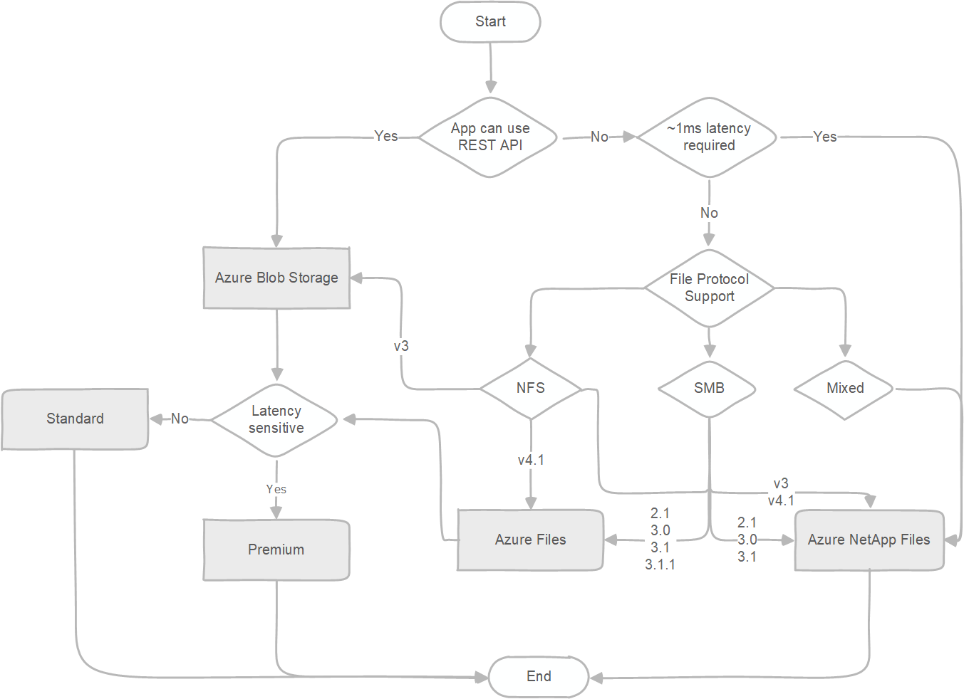

Slide 7
To keep the decision tree simple, limits of the target storage service aren't incorporated in the diagram. To find out more about current limits, and to determine whether you need to modify your choices based on them, see:
Storage account limits
Blob Storage limits
Azure Files scalability and performance targets
Azure NetApp Files resource limits
If any of the limits pose a blocker for using a service, Azure supports several storage vendors that offer their solutions on Azure Marketplace. For information about validated ISV partners that provide file services, see Azure Storage partners for primary and secondary storage.

Slide 8
Select the migration method
There are two basic migration methods for storage migrations.
Online. The online method uses the network for data migration. Either the public internet or Azure ExpressRoute can be used. If the service doesn't have a public endpoint, you must use a VPN with public internet.
Offline. The offline method uses one of the Azure Data Box devices.
The decision to use an online method versus an offline method depends on the available network bandwidth. The online method is preferred in cases where there's sufficient network bandwidth to perform a migration within the needed timeline.
It's possible to use a combination of both methods, offline method for the initial bulk migration and an online method for incremental migration of changes. Using both methods simultaneously requires a high level of coordination and isn't recommended for this reason. If you choose to use both methods isolate the data sets that are migrated online from the data sets that are migrated offline.
For more information about the different migration methods and guidelines, see Choose an Azure solution for data transfer and Migrate to Azure file shares.
Choose the best migration tool for the job
There are various migration tools that you can use to perform the migration. Some are open source like AzCopy, robocopy, xcopy, and rsync while others are commercial. List of available commercial tools and comparison between them is available on our comparison matrix.
Open-source tools are well suited for small-scale migrations. For migration from Windows file servers to Azure Files, Microsoft recommends starting with Azure Files native capability and using Azure File Sync. For more complex migrations consisting of different sources, large capacity, or special requirements like throttling or detailed reporting with audit capabilities, commercial tools are the best choice. These tools make the migration easier and reduce the risk significantly. Most commercial tools can also perform the discovery, which provides a valuable input for the assessment.

Slide 9
Migration phase
The migration phase is the final migration step that does data movement and migration. Typically, you'll run through the migration phase several times to accomplish an easier switchover. The migration phase consists of the following steps:
Initial migration. The initial migration step migrates all the data from the source to the target. This step migrates the bulk of the data that needs to be migrated.
Resync. A resync operation migrates any data that was changed after the initial migration step. You can repeat this step several times if there are numerous changes. The goal of running multiple resync operations is to reduce the time it takes for the final step. For inactive data and for data that has no changes (like backup or archive data), you can skip this step.
Final switchover. The final switchover step switches the active usage of the data from the source to the target and retires the source.
The duration of the migration for unstructured data depends on several aspects. Outside of the chosen method, the most critical factors are the total size of the data and file size distribution. The bigger the total data set, the longer the migration time. The smaller the average file size, the longer the migration time. If you have a large number of small files consider archiving them in larger files (like to a .tar or .zip file), if applicable, to reduce the total migration time.

Slide 10
Migration of block-based devices
Migration of block-based devices is typically done as part of virtual machine or physical host migration. It's a common misconception to delay block storage decisions until after the migration. Making these decisions ahead of time with appropriate considerations for workload requirements leads to a smoother migration to the cloud.

Slide 11
Azure Storage is a Microsoft-managed cloud storage service, that provides highly available, durable, scalable and redundant storage, at a fraction of the cost, if you were to manage it manually. In this blog on Azure Storage, you will learn the different storage offerings from Azure such as tables, blobs, file storage and queues! Towards the end, we have also included a demonstration of all these services in Azure.

Slide 12
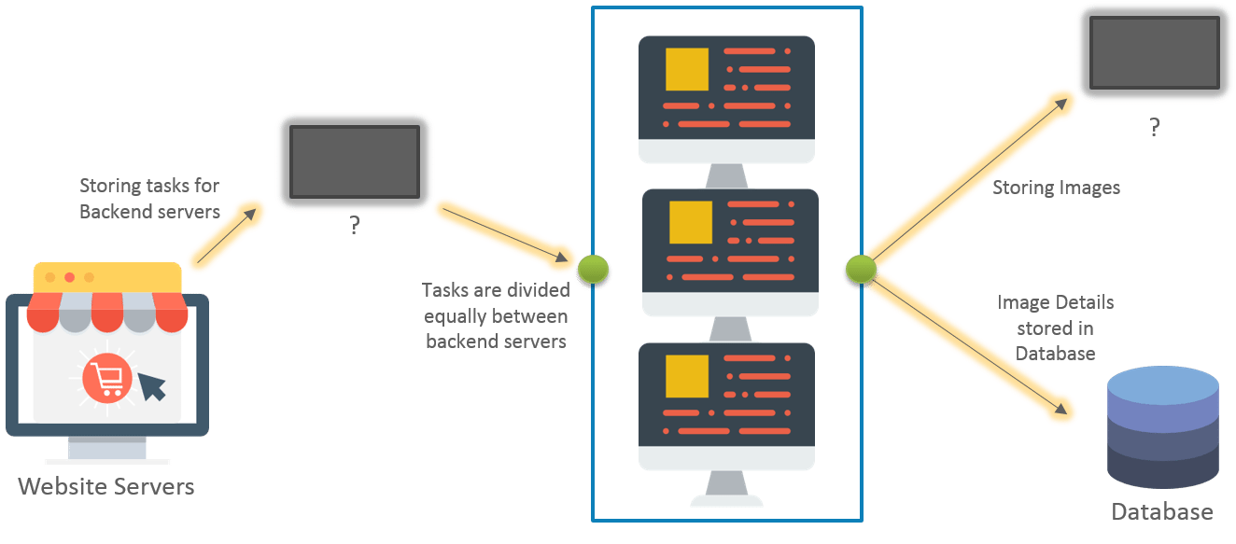
Why Do We Need Storage?
Let’s understand this using an example, consider the following architecture:

Slide 13
This architecture is for an image processing website. We have tried to distribute the load among two classes of servers, namely website servers and backend servers. The website server’s sole job would be to handle the incoming page requests for our website. The backend servers will handle any “processing” that would be needed corresponding to an operation, which in our case would be image processing. There are two blank “entities” which are unknown.
The first entity will be needed to store the incoming jobs from our website servers. These jobs will be picked up by the backend servers to execute the job. Once a job has been completed, it has to be removed from this entity so that no other server picks it up to process again, since it’s already been processed.
You might be wondering, why can’t we just store this list on the backend servers? This is because, we will be needing multiple backend servers for our use case. So this list has to be present on each backend server, and on each successful job completion, all the servers will have to update their list. Now, this becomes a daunting task.
Hence, we needed a better solution. Therefore, we came up with a common location which is accessible to all the backend servers, where all our jobs can be stored on a first come first serve basis, this came to be known as a queue.
The second unknown entity is needed to store the processed images. We needed something which can store our images with minimum processing overhead. The obvious answer was a file system for storage.
Concluding, we needed a queue storage for our first entity, and for our second entity we needed a file system. But why do we need a file system rather than a database for storing our images or jobs?

Slide 14
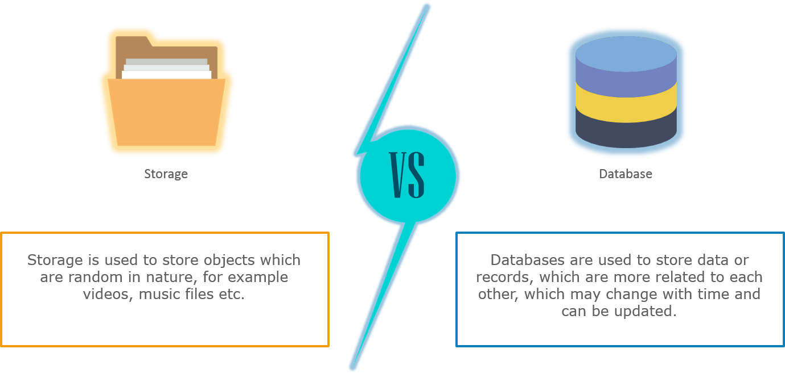
Storage vs Database

Slide 15
File systems not only require lower processing, they are easy to access as well. If you store images on database, you would have to do a query request to database, every time you need an image. Imagine the same case with a file system, it will not take that much processing because accessing a file is quite simple and light weight. Also, database storage is more expensive than file system storage.

Slide 16
Blob Storage
Blob storage accounts are specialized in storing blob data and can also be used to choose an access tier, which allows you to specify how frequently data in the account is accessed. You can choose an access tier suitable for your storage and which suits your expenses.
There are two types of access tier:
Hot: This access tier grants us the lowest latency possible. Hence, it should be used with data which is frequently accessed. Naturally, since it offers low latency it is more expensive.
Cold: This access tier is less in performance than the “Hot” access tier i.e offers higher latency than the former access tier. That being said, it comes with a lesser price tag and hence can be used for data which is less frequently accessed.
Moving on, both these storage account types i.e blob storage and general purpose storage account are designed to be highly available. With high availability, you can be assured that your files hosted on azure will be available 24×7. And high availability is only possible using replication.

